Slide 1
Historical overview of optical networks
http://developers.sun.com/mobility/midp/articles/bluetooth2/

Slide 2
Historical overview of optical networks
Optical fiber provides several advantages
  Unprecedented bandwidth potential far in excess of any other known transmission medium
  A single strand of fiber offers a total bandwidth of 25 000 GHz <=> total radio bandwidth on Earth <25 GHz
  Apart from enormous bandwidth, optical fiber provides additional advantages (e.g., low attenuation)
Optical networks aim at exploiting unique properties of fiber in an efficient & cost-effective manner

Slide 3
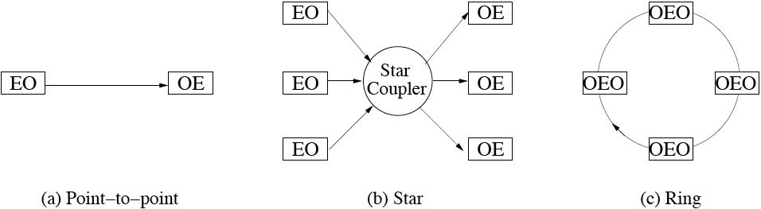
Historical overview of optical networks
Optical networks
  (a) Point-to-point link
    Initially, optical fiber used for point-to-point transmission systems between pair of transmitting and receiving nodes
    Transmitting node: converts electrical data into optical signal (EO conversion) & sends it on optical fiber
    Receiving node: converts optical signal back into electrical domain (OE conversion) for electronic processing & storage

Slide 4
Historical overview of optical networks
Optical networks
  (b) Star network
    Multiple point-to-point links are combined by a star coupler to build optical single-hop star networks
    Star coupler is an optical broadcast device that forwards an optical signal arriving at any input port to all output ports
    Similar to point-to-point links, transmitters perform EO conversion and receivers perform OE conversion

Slide 5
Historical overview of optical networks
Optical networks
  (c) Ring network
    Interconnecting each pair of adjacent nodes with point-to-point fiber links leads to optical ring networks
    Each ring node performs OE and EO conversion for incoming & outgoing signals, respectively
    Combined OE & EO conversion is called OEO conversion
    Real-world example: fiber distributed data interface (FDDI)

Slide 6
Historical overview of optical networks
SONET/SDH
  Synchronous optical network (SONET) & its closely related synchronous digital hierarchy (SDH) standard is one of the most important standards for optical point-to-point links
  Brief SONET history
    Standardization began during 1985
    First standard completed in June 1988
    Standardization goals were to specify optical point-to-point transmission signal interfaces that allow
      interconnection of fiber optics transmission systems of different carriers & manufacturers
      easy access to tributary signals
      direct optical interfaces on terminals
      to provide new network features

Slide 7
Historical overview of optical networks
SONET/SDH
  SONET defines
    standard optical signals
    synchronous frame structure for time division multiplexed (TDM) digital traffic
    network operation procedures
  SONET based on digital TDM signal hierarchy with periodically recurring time frame of 125 µs
  SONET frame structure carries payload traffic of various rates & several overhead bytes to perform network operations (e.g., error monitoring, network maintenance, and channel provisioning)

Slide 8
Historical overview of optical networks
SONET/SDH
  Globally deployed by large number of major network operators
  Typically, SONET point-to-point links used to build optical ring networks with OEO conversion at each node
  SONET rings deploy two types of OEO nodes
    Add-drop multiplexer (ADM)
      Usually connects to several SONET end devices
      Aggregates or splits SONET traffic at various speeds
    Digital cross-connect system (DCS)
      Adds and drops individual SONET channels at any location
      Able to interconnect a larger number of links than ADM
      Often used to interconnect SONET rings

Slide 9
Historical overview of optical networks
Multiplexing
  Rationale
    Huge bandwidth of optical fiber unlikely to be used by single client or application => bandwidth sharing among multiple traffic sources by means of multiplexing
  Three major multiplexing approaches in optical networks
    Time division multiplexing (TDM)
    Space division multiplexing (SDM)
    Wavelength division multiplexing (WDM)

Slide 10
Historical overview of optical networks
Multiplexing
  Time division multiplexing (TDM)
    SONET/SDH is an important example of optical TDM networks
    TDM is well understood technique used in many electronic network architectures throughout 50-year history of digital communications
    In high-speed optical networks, however, TDM is limited by the fastest electronic transmitting, receiving, and processing technology available in OEO nodes, leading to so-called electro-optical bottleneck
    Due to electro-optical bottleneck, optical TDM networks face severe problems to fully exploit enormous bandwidth of optical fibers

Slide 11
Historical overview of optical networks
Multiplexing
  Space division multiplexing (SDM)
    SDM is straightforward solution to electro-optical bottleneck
    In SDM, single fiber is replaced with multiple fibers used in parallel, each operating at any arbitrary line rate (e.g., electronic peak rate of OEO transceiver)
    SDM well suited for short-distance transmissions
    SDM becomes less practical and more costly for increasing distances since multiple fibers need to be installed and operated

Slide 12
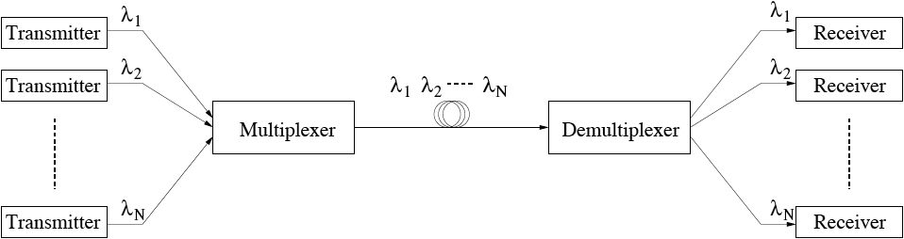
Historical overview of optical networks
Multiplexing
  Wavelength division multiplexing (WDM)
    WDM can be thought of as optical FDM where traffic from each client is sent on different wavelength
    Multiplexer combines wavelengths onto common outgoing fiber link
    Demultiplexer separates wavelengths and forwards each wavelength to separate receiver

Slide 13
Historical overview of optical networks
Multiplexing
  WDM appears to be the most promising approach to tap into vast amount of fiber bandwidth while avoiding shortcomings of TDM and SDM
    Each WDM wavelength may operate at arbitrary line rate well below aggregate TDM line rate
    WDM takes full advantage of bandwidth potential without requiring multiple SDM fibers => cost savings
  Optical WDM networks widely deployed & studied by network operators, manufacturers, and research groups worldwide
  Existing & emerging high-performance optical networks are likely to deploy all three multiplexing techniques, capitalizing on the respective strengths of TDM, SDM, and WDM

Slide 14
Historical overview of optical networks
Optical TDM networks
  Progress on very short optical pulse technology enables optical TDM (OTDM) networks at 100 Gb/s and above
  High-speed OTDM networks have to pay particular attention to transmission properties of optical fiber
  In particular, dispersion significantly limits achievable bandwidth-distance product of OTDM networks due to intersymbol interference (ISI)
    With ISI, optical power of adjacent bits interfere, leading to changed optical power levels & transmission errors
    ISI is exacerbated for increasing data rates and fiber lengths => decreased bandwidth-distance product
  OTDM networks well suited for short-range applications
  Long-distance OTDM networks can be realized by using soliton propagation, where dispersion effects are cancelled out by nonlinear effects of optical fiber

Slide 15
Historical overview of optical networks
Optical TDM networks
  Optical TDM networks have two major disadvantages
    Synchronization is required, which becomes more challenging for increasing data rates of >100 Gb/s
    Lack of transparency since OTDM network clients have to match their traffic and protocols to underlying TDM frame structure
  Using optical switching components with electronic control paves way to transparent OTDM networks
  However, transparent OTDM networks are still in their infancy
  Optical WDM networks are widely viewed as more mature solution to realize transparent optical networks
    WDM networks do not require synchronization
    Each wavelength may be operated separately, providing transparency against data rate, modulation & protocol

Slide 16
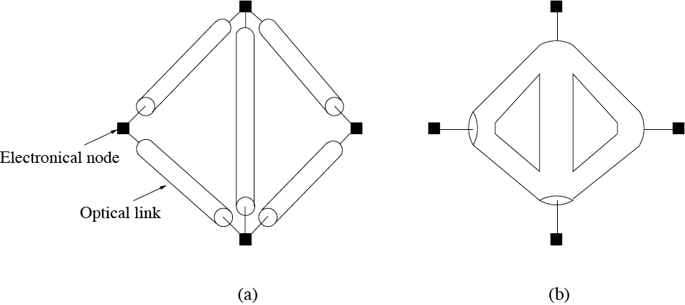
Historical overview of optical networks
Optical WDM networks
  Optical WDM networks are networks that deploy WDM fiber links with or without OEO conversion at intermediate nodes
  Optical WDM networks can be categorized into
    (a) Opaque WDM networks => OEO conversion
    (b) Transparent WDM networks => optical bypassing
    (a)+(b) Translucent WDM networks

Slide 17
Historical overview of optical networks
All-optical networks (AONs)
  AONs provide purely optical end-to-end paths between source and destination nodes by means of optically bypassing intermediate nodes => optical transparency
  AONs are widely applicable and can be found at all network hierarchy levels
  Typically, AONs are optical circuit-switched (OCS) networks
    Optical circuits usually switched at wavelength granularity => wavelength-routing networks
  AONs deploy all-optical (OOO) node structures which allow optical signals to stay partly in the optical domain
  Unlike OEO nodes, OOO nodes do not perform OEO conversion of all wavelength channels => in-transit traffic makes us of optical bypassing

Slide 18
Historical overview of optical networks
AONs vs. SONET/SDH networks
  Several similarities and analogies between AONs and SONET/SDH networks
    Both networks are circuit-switched systems
    TDM slot multiplexing, processing, and switching in SONET/SDH networks <=> WDM wavelength channel multiplexing, processing, and switching in AONs
    Add-drop multiplexer (ADM) & digital cross-connect system (DCS) in SONET/SDH networks <=> All-optical replica of ADM & DCS in AONs
      Optical add-drop multiplexer (OADM)/wavelength add-drop multiplexer (WADM)
      Optical cross-connect (OXC)/wavelength-selective cross-connect (WSXC)

Slide 19
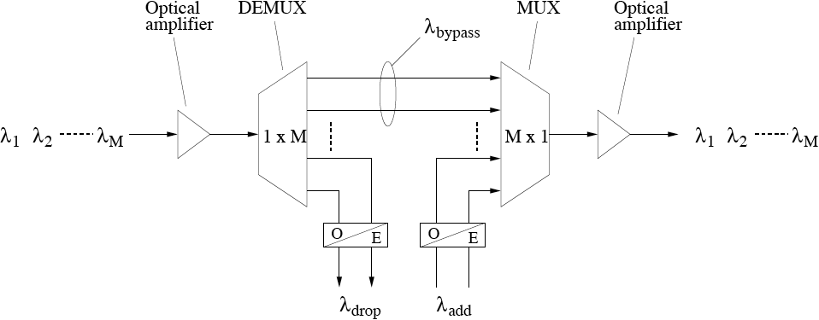
Historical overview of optical networks
OADM
  Incoming WDM comb signal optically amplified (e.g., EDFA) & demultiplexed (DEMUX) into separate wavelengths
  Wavelengths λ_{bypass} remain in optical domain
  Traffic on wavelengths λ_{drop} locally dropped
  Local traffic inserted on freed wavelengths λ_{add}
  Wavelengths multiplexed (MUX) & amplified on outgoing fiber

Slide 20
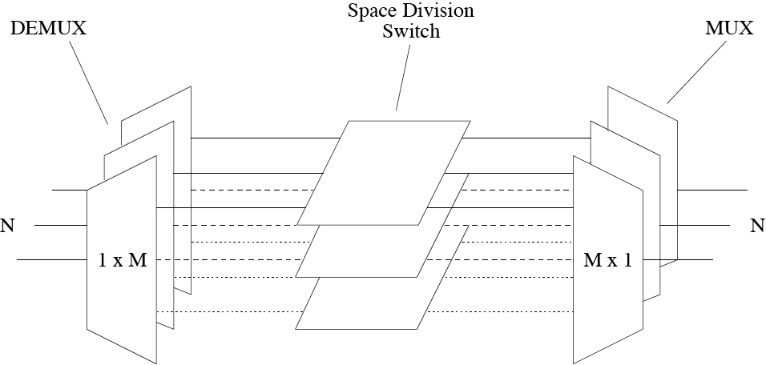
Historical overview of optical networks
OXC
  N x N x M component with N input fibers, N output fibers, and M wavelength channels on each fiber
  Each input fiber deploys DEMUX & optical amplifier (optional)
  Each wavelength layer uses separate space division switch
  Each output fiber deploys DEMUX to collect light from all wavelength layers (plus optional optical amplifier)

Slide 21
Historical overview of optical networks
Optical transport network (OTN)
  An AON deploying OADMs and OXCs is referred to as optical transport network (OTN)
  Benefits of OTN
    Substantial cost savings due to optical bypass capability of OADMs & OXCs
    Improved network flexibility and survivability by using reconfigurable OADMs (ROADMs) and reconfigurable OXCs (ROXCs)

Slide 22
Historical overview of optical networks
AONs: Design Goals & Constraints
  Two major design goals of AONs
    Scalability
    Modularity
  Transparency enables cost-effective support of large number of applications, e.g.,
    Voice, video, and data
    Uncompressed HDTV
    Medical imaging
    Interconnection of supercomputers
  Physical transmission impairments pose limitations on number of network nodes, used wavelengths, and distances => Large AONs must be partitioned into several subnetworks called islands of transparency

Slide 23
Historical overview of optical networks
AONs: Design Goals & Constraints
  AONs offer two types of optical paths
    Lightpath: optical point-to-point path
    Light-tree: optical point-to-multipoint path
  Lightpath and light-tree may
    be optically amplified
    keep assigned wavelength unchanged => wavelength continuity constraint
    have assigned wavelength altered along path => wavelength conversion
  OXCs equipped with wavelength converters are called wavelength-interchanging cross-connects (WIXCs)
  WIXCs improve flexibility of AONs and help decrease blocking probability in AONs since wavelength continuity constraint can be omitted

Slide 24
Historical overview of optical networks
Wavelength conversion
Type | Definition
Fixed conversion | Static mapping between input wave-length λ_{i} and output wavelength λ_{j}
Limited-range conversion | Input wavelength λ_{i} can be mapped to a subset of available output wavelengths
Full-range conversion | Input wavelength λ_{i} can be mapped to all available output wavelengths
Sparse conversion | Wavelength conversion is supported only by a subset of network nodes

Slide 25
Historical overview of optical networks
Wavelength conversion
  Wavelength converters may be realized
    by OE converting optical signal arriving on wavelength λ_{i} and retransmitting it on wavelength λ_{j} (implying OEO conversion)
    by exploiting fiber nonlinearities (avoiding OEO conversion)
  Benefits of wavelength converters
    Help resolve wavelength conflicts on output links => reduced blocking probability
    Increase spatial wavelength reuse => improved bandwidth efficiency
  At the downside, wavelength converters are rather expensive => solutions to cut costs
    Sparse wavelength conversion
    Converter sharing inside WIXC
      Converter share-per-node approach
      Converter share-per-link approach

Slide 26
Historical overview of optical networks
Reconfigurability
  Beneficial property of dynamically rerouting and load balancing of traffic in response to traffic load changes and/or network failures in order improve network flexibility & performance
  Reconfigurable AONs may be realized by using
    Tunable wavelength converters (TWCs)
    Tunable transmitters & receivers
    Multiwavelength transmitters & receivers
    Reconfigurable OXCs (ROXCs)
    Reconfigurable OADMs (ROADMs)

Slide 27
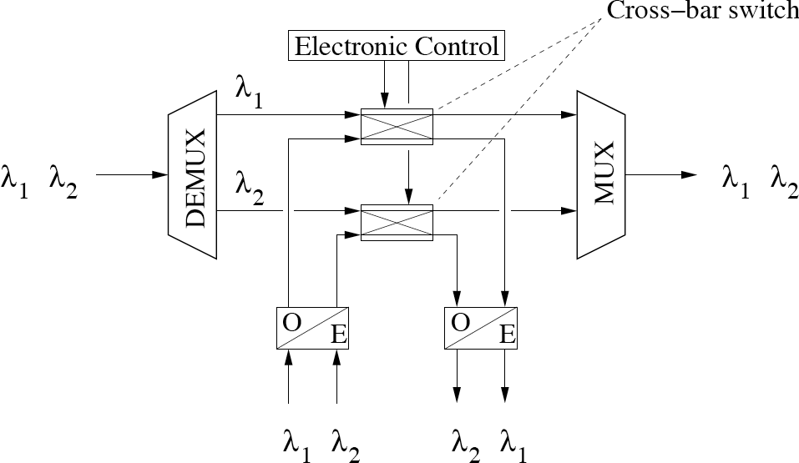
Historical overview of optical networks
ROADM
  Conventional OADM becomes reconfigurable by using optical 2 x 2 cross-bar switches on in-transit paths between DEMUX and MUX
  Cross-bar switches are electronically controlled independently from each other to locally drop/add (cross state) or forward (bar state) traffic on separate wavelengths

Slide 28
Historical overview of optical networks
Control & Management
  Reconfigurable AONs allow to realize powerful telecommunications network infrastructures, but also give rise to some problems
    Find optimal configuration for given traffic scenario
    Provide best reconfiguration policies in presence of traffic load changes, network failures, and network upgrades
    Guarantee proper and efficient operation
  To solve these problems, control & management of reconfigurable AONs is key to make them commercially viable

Slide 29
Historical overview of optical networks
Control
  Adding control functions to AONs allows to
    set up
    modify and
    tear down
  optical circuits such as lightpaths and light-trees by (re)configuring tunable transceivers, tunable wavelength converters, ROXCs, and ROADMs along the path
  AONs typically use a separate wavelength channel called optical supervisory channel (OSC) to distribute control & management information among all network nodes

Slide 30
Historical overview of optical networks
OSC
  Unlike optically bypassing data wavelength channels, OSC is OEO converted at each network node (e.g., electronic controller of ROADM)
  OSC enables both distributed and centralized control of tunable/reconfigurable network elements
    Distributed control
      Any node is able to send control information to network elements and thus remotely control their state
    Centralized control
      A single entity is authorized to control the state of network elements
      Central control entity traditionally part of network management system (NMS)

Slide 31
Historical overview of optical networks
NMS
  NMS acquires and maintains global view of current network status by
    issuing requests to network elements and
    processing responses and update notifications sent by network elements
  Each network element determines and continuously updates link connectivity & link characteristics to its adjacent nodes, stores this information in its adjacency table, and sends its content to NMS
  NMS uses this information of all nodes in order to
    construct & update view of current topology, node configuration, and link status of entire network
    set up, modify, and tear down optical end-to-end connections
  Telecommunications Management Network (TMN) framework plays major role in reconfigurable AONs

Slide 32
Historical overview of optical networks
TMN
  Jointly standardized by ITU-T and ISO
  Incorporates wide range of standards that cover management issues of the so-called FCAPS model
    Fault management
    Configuration management
    Accounting management
    Performance management
    Security management

Slide 33
Historical overview of optical networks
FCAPS model
  Fault management
    Monitoring & detecting fault conditions
    Correlating internal & external failure symptoms
    Reporting alarms to NMS
    Configuring restoration mechanisms
  Configuration management
    Provides connection set-up and tear-down capabilities
    Paradigms for connection set-up and release
      Management provisioning (initiated by network administrator via NMS interface)
      End-user signaling (initiated by end user via signaling interface without intervention by NMS)

Slide 34
Historical overview of optical networks
FCAPS model
  Accounting management
    Also known as billing management
    Provides mechanisms to record resource usage & charge accounts for it
  Performance management
    Monitoring & maintaining quality of established optical circuits
  Security management
    Comprises set of functions that protect network from unauthorized access (e.g., cryptography)

